Slide 1
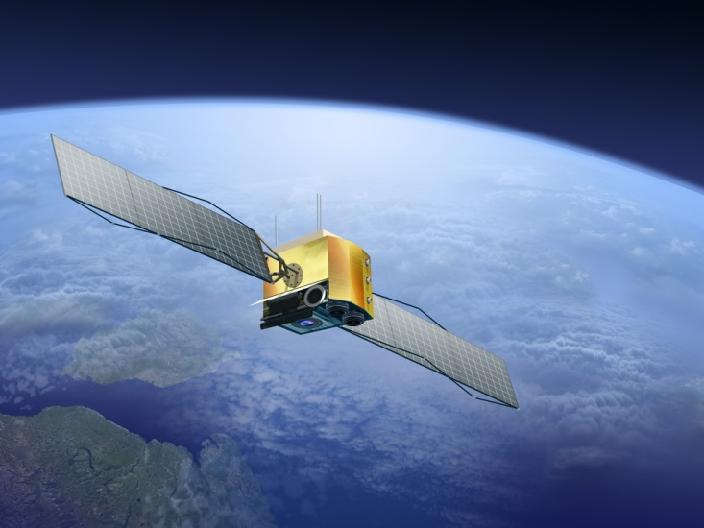


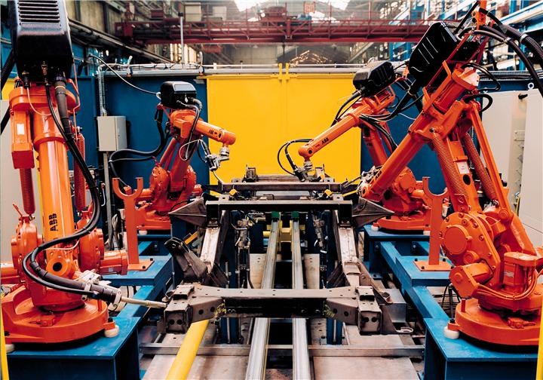
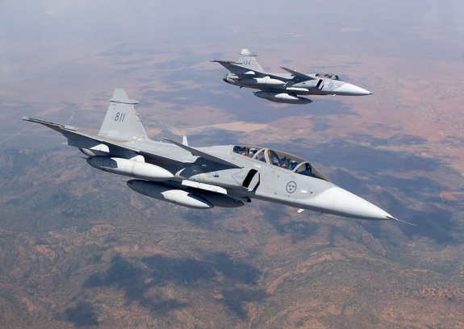


Percepio Tracealyzer™
Revealing the runtime world

Slide 2

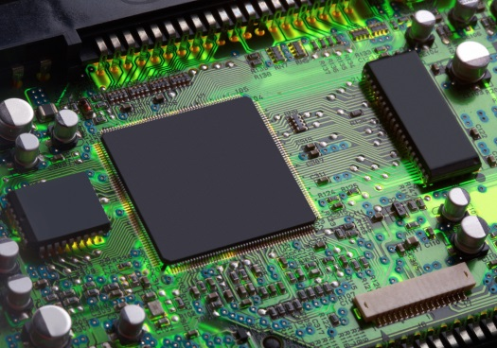
Software behavior depends on timing Source code alone does not give the full picture…
?

Slide 3
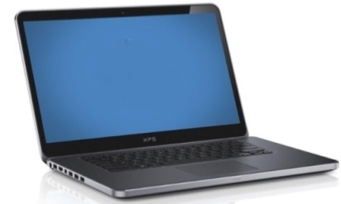
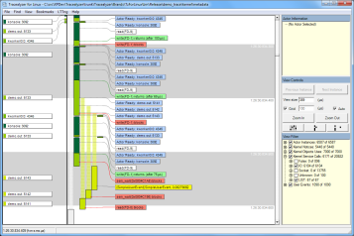
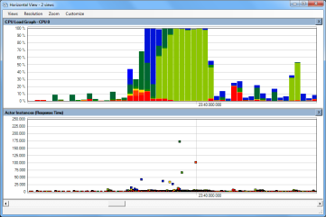
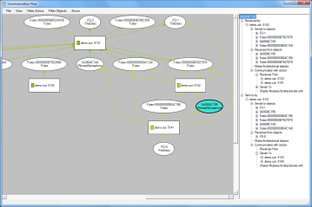
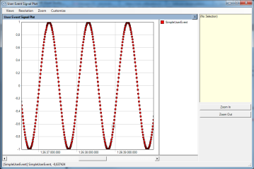
Tracealyzer shows what’s going on!

Slide 4
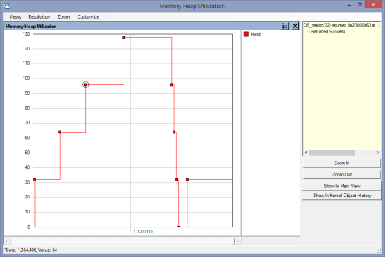
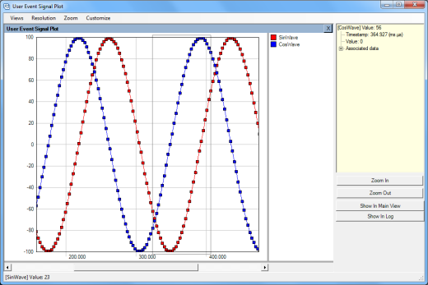
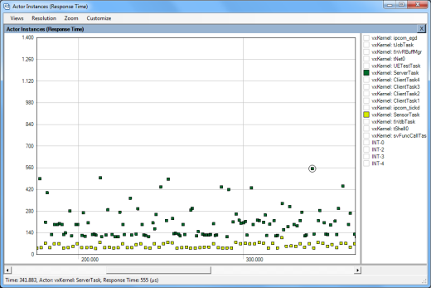
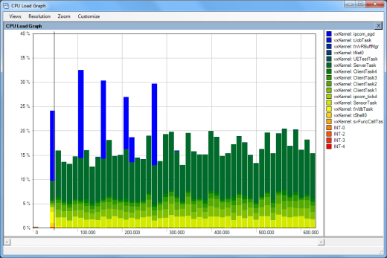
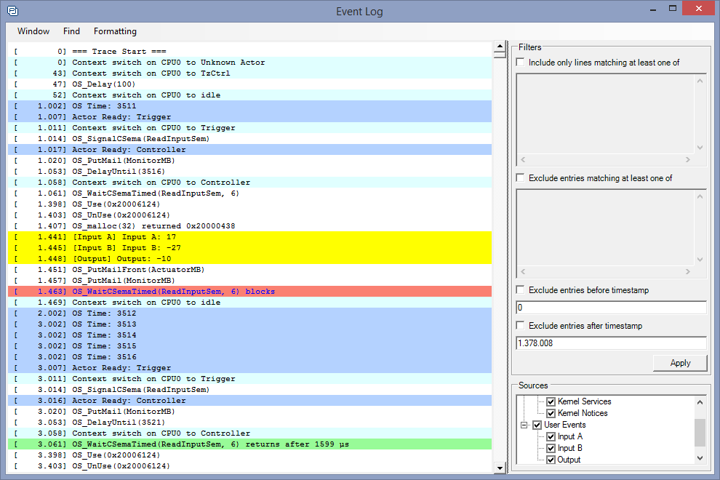
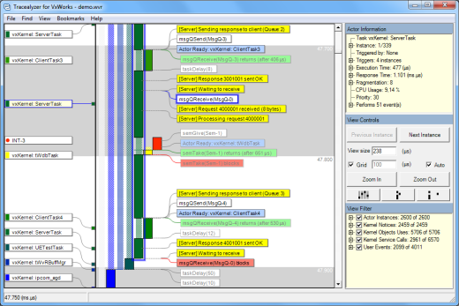
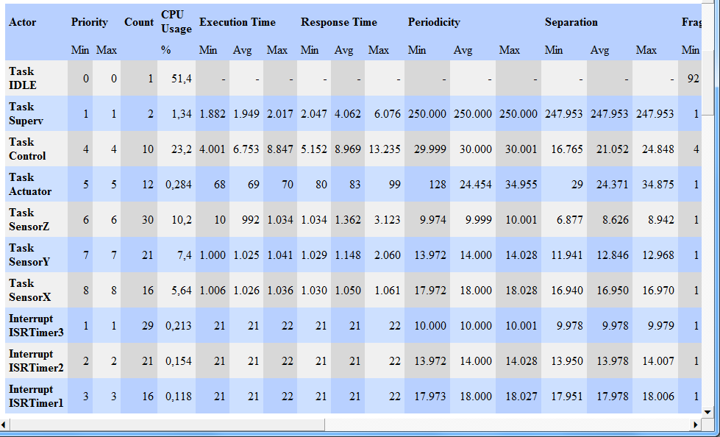
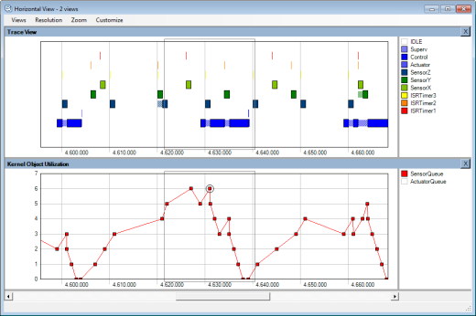
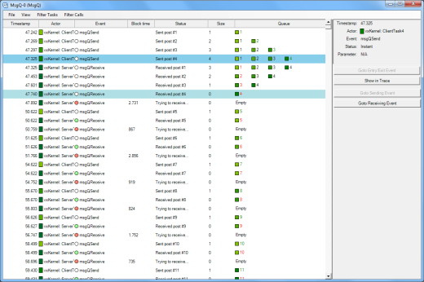
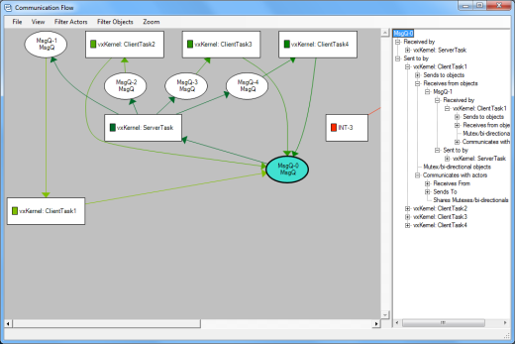
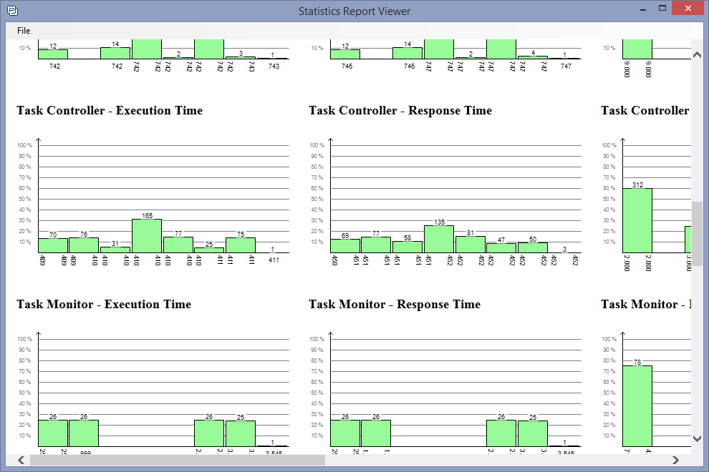
25+ Cleverly Connected Views

Slide 5


Increasing Development Efficiency and Software Performance
Debugging
RTOS and timing issues
Validation
Code running as intended?
Profiling
RAM and CPU usage per task?
Training
Learn RTOS concepts & services
Documentation
Visualize designs or issues
“In less than 5 days from running the tool, we improved the performance of our graphic rendering engine by 3x!” Terry West, CEO, Serious Integrated Inc.
“FreeRTOS+Trace has doubled our development speed. Problems that otherwise would take days to solve are obvious with this tool and just a quick fix. We use it all the time.” Alex Pabouctisids, Lead Firmware Engineer, Flyability.

Slide 6
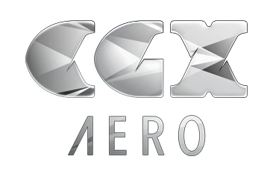



For Leading Companies
Percepio’s tracing tool allowed me to quickly understand and solve serious multi-threading issues, that otherwise would have taken least two weeks to analyze. I got started and solved the first issue in a single day. I strongly recommend Percepio’s tracing tools.” Chaabane Malki, Embedded Systems Engineer, CGX Aero
ABB Robotics is using the first generation Tracealyzer in all of the IRC5 robot controllers shipped since 2005. The tool has proven its value many times in all corners of the world.” Roger Kulläng, Global System Architect, ABB Robotics.
”In today’s tough competition with time-to-market pressure constantly increasing, visualization support is natural for software developers in order to produce software of higher quality, in shorter time and at a lower cost. We choose Tracealyzer from Percepio.” Jörgen Appelgren, R&D Manager, Atlas Copco Rock Drills
“The many system views of the Tracealyzer from Percepio makes it easy to quickly find solutions that we have not seen using (Wind River) System Viewer. The visualization has several advantages over the system viewer and makes it easier to understand system behavior. This tool would be of great use for us.” Johan Fredriksson, Software Architect, SAAB AB.

Slide 7






For Leading Software Platforms
Linux
VxWorks
FreeRTOS
µC/OS-III
SafeRTOS
embOS
And a few others…

Slide 8
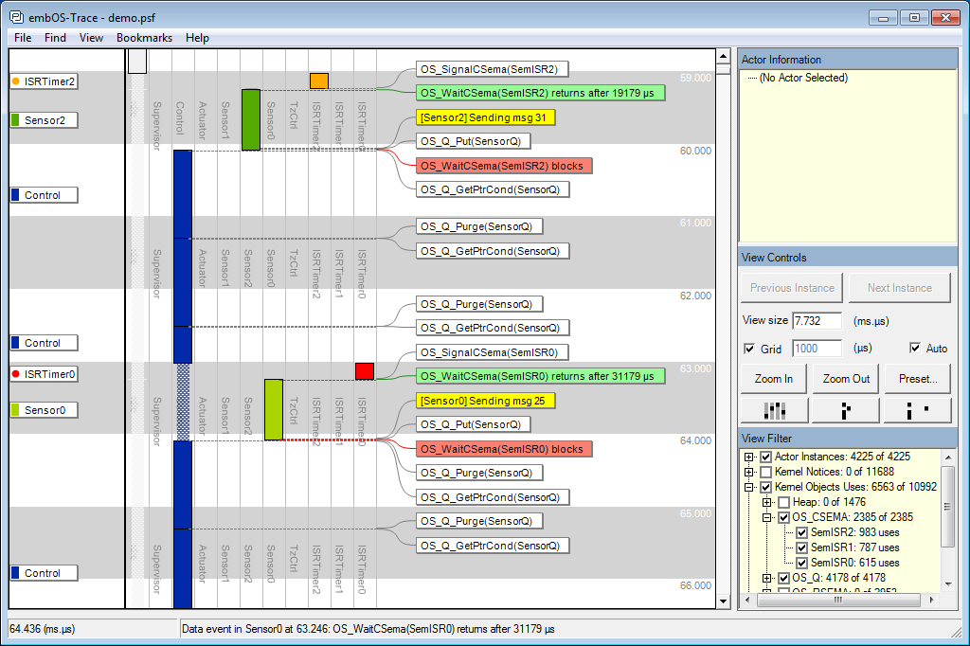
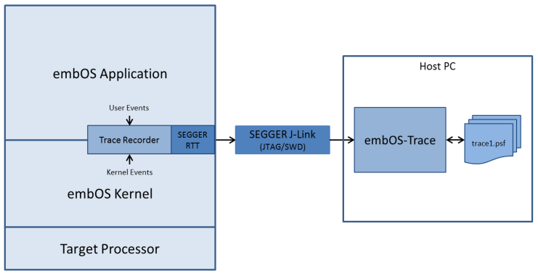
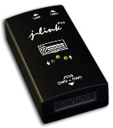
Tracealyzer for embOS
Continuous trace streaming via SEGGER J-Link debug probes, for ARM Cortex-M devices.
“With the increasing complexity of embedded software, runtime visualization is becoming a ‘must-have’ in the developers’ toolbox. Percepio offers an amazing visualization tool that without doubt will be very useful for many embedded developers.”
Dirk Akemann, Partnership Marketing Manager, SEGGER

Slide 9
Main trace view: Vertical timeline of task scheduling, interrups, RTOS API calls
and custom ”user events”. Use the ”View Filter” to select what events to see.

Slide 10
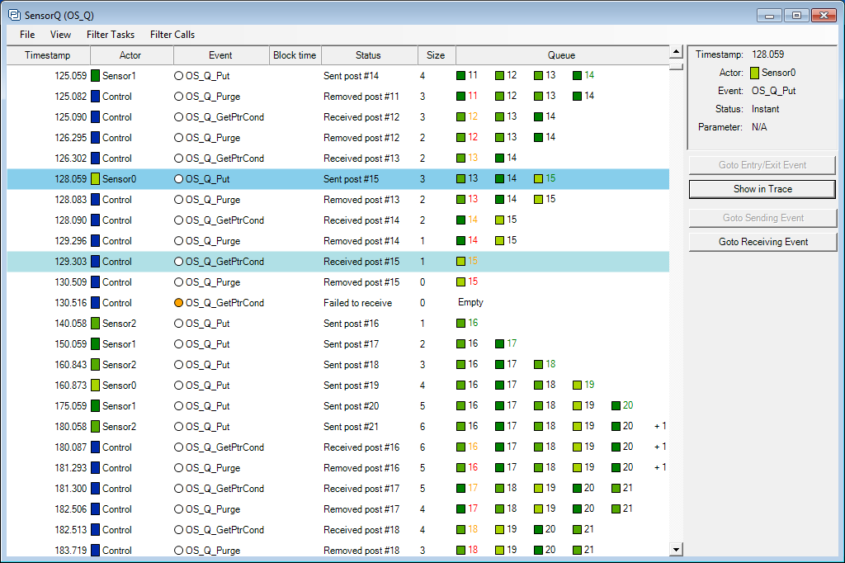
Object History View: A focused timeline for a specific kernel object (e.g., a queue).
Opens when you double-click an event label in the main view.

Slide 11
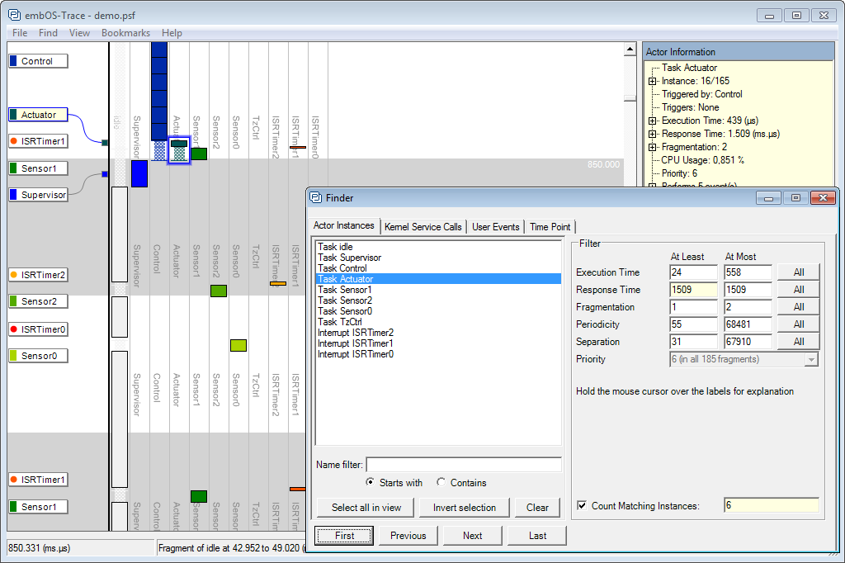
Finder dialog: Easily find tasks executions or events with powerful filters.

Slide 12
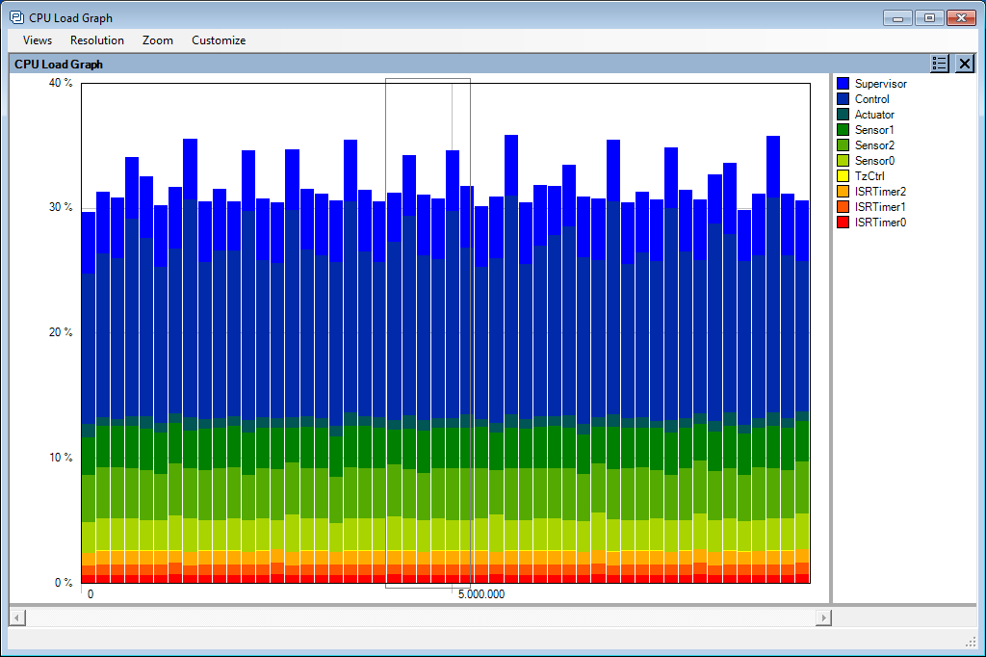
CPU Load Graph: Usage of processor cycles over time, per task and ISR.

Slide 13
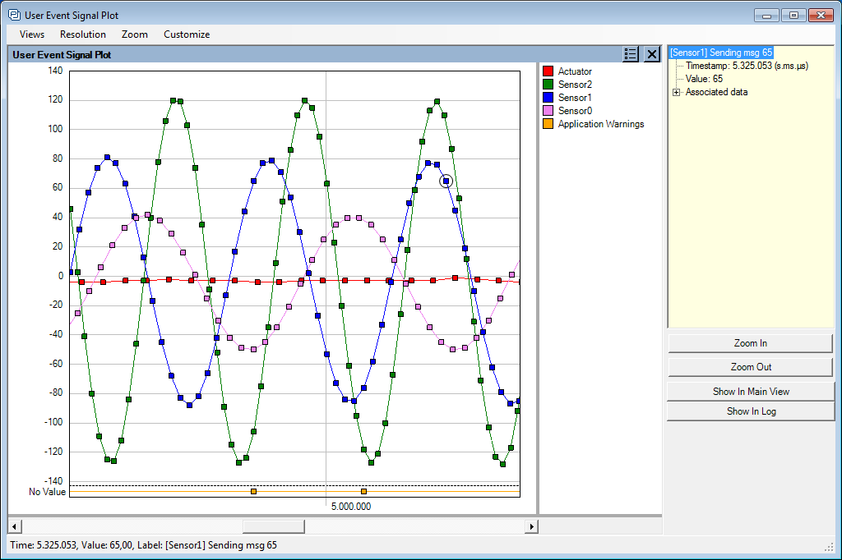
User Event Signal Plot: Application data from ”User Event” log.

Slide 14
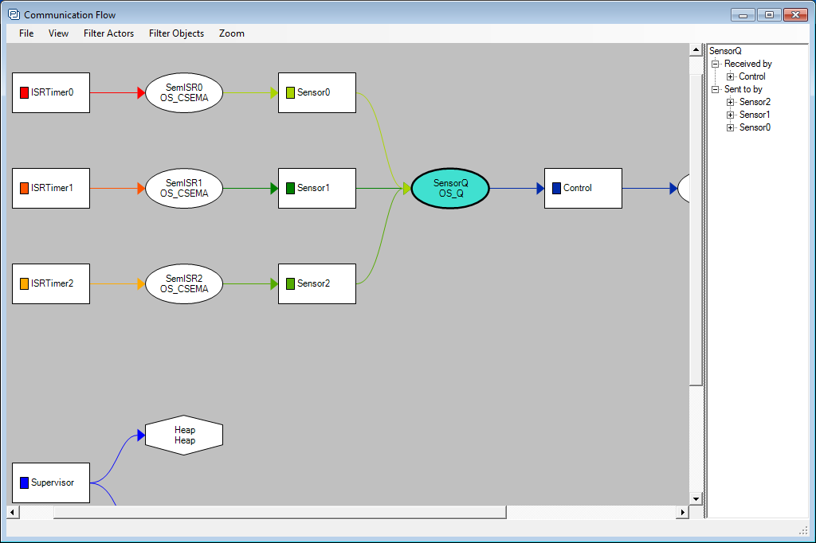
Communication Flow graph: shows the dependencies/interactions.

Slide 15
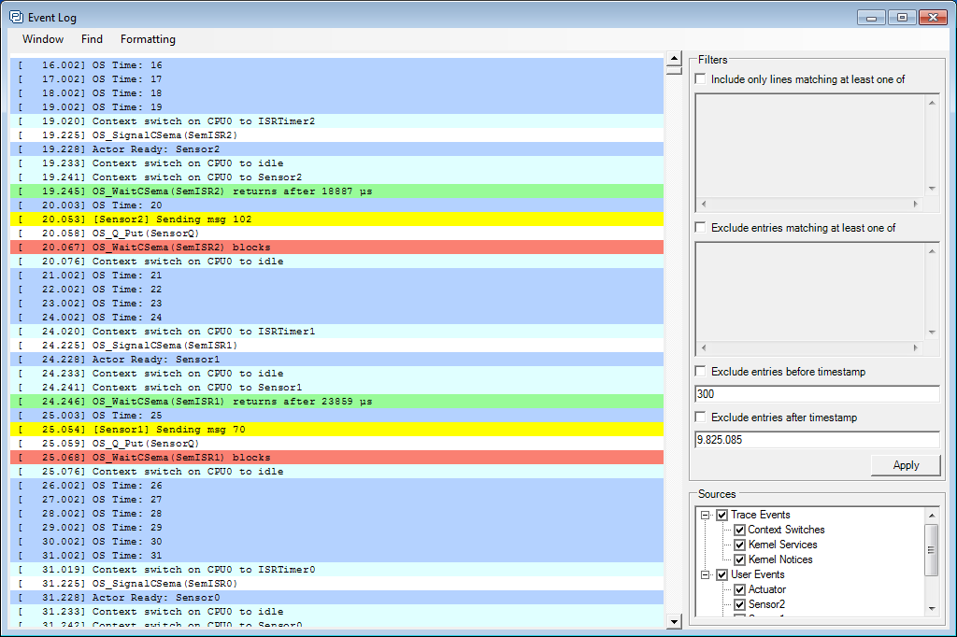
Event Log: Shows event list in text format for detailed inspection, with color coding,
search/filtering and text export functions.

Slide 16
Learn more and download at www.percepio.com

